Slide 1
Reddit Analysis Report
June 6th, 2024

Slide 2
Objective Question
Should financial firms track their reputation on Reddit?
Charles Schwab Corporation
2

Slide 3






First Half Plan
Data Scraping & Cleaning
Sentiment Analysis
Topic Modeling
Second Half Plan
Network Analysis
Sentiment Analysis
Software Development
Charles Schwab Corporation
3

Slide 4
10 Subreddits
Past Progress
Charles Schwab Corporation
4

Slide 5
Analyzed Subreddits & Member Count
r/Fidelity
Investments
r/WallStreetBets
r/Investing
r/Robinhood
r/Bogleheads
15M
2.6M
1M
425K
119K
r/Investingfor
beginners
r/Robinhood
Trade
r/Schwab
r/TastyTrade
r/JPMorgan
47K
33K
31K
5.7K
371
Charles Schwab Corporation
5

Slide 6
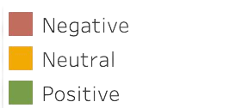
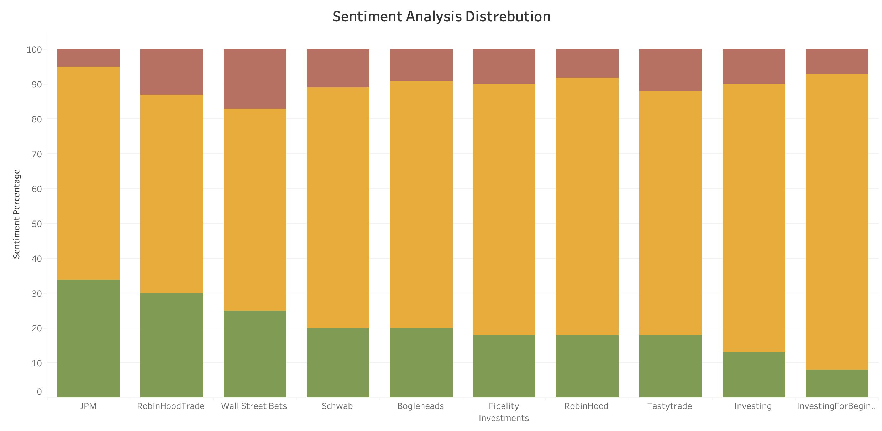
Overall Sentiment Distribution
6
Notes:
Wes

Slide 7
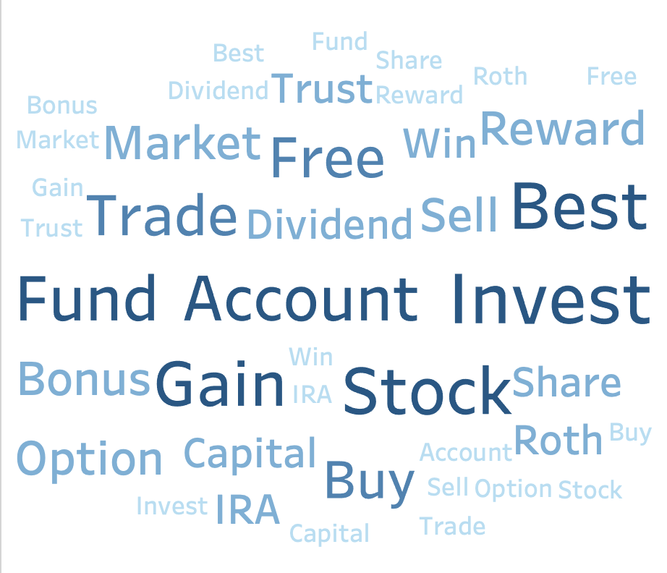
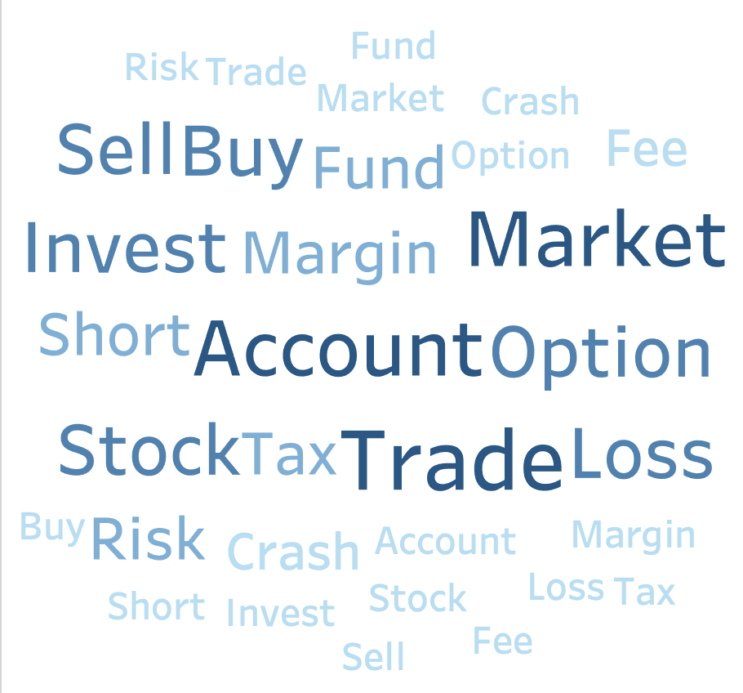
Overall Word Clouds
Positive
Negative
7

Slide 8
Now…
What’s new?
Charles Schwab Corporation
8

Slide 9
What’s new?
Comments and Product
Sentiment Analysis
Charles Schwab Corporation
9

Slide 10
We Focused on Charles Schwab & Top 3 Subreddits
r/WallStreetBets
r/Investing
15M
2.6M
r/Robinhood
r/Schwab
1M
33K
Charles Schwab Corporation
10

Slide 11
Subreddit Comment
Sentiment Results
50
50
55
48
27
30
19
22
Negative
Neutral
Positive
Negative
Neutral
Positive
r/WallStreetBets
r/Investing
50
50
42
50
40
30
18
20
Negative
Neutral
Positive
Negative
Neutral
Positive
r/Robinhood
r/Schwab
11

Slide 12
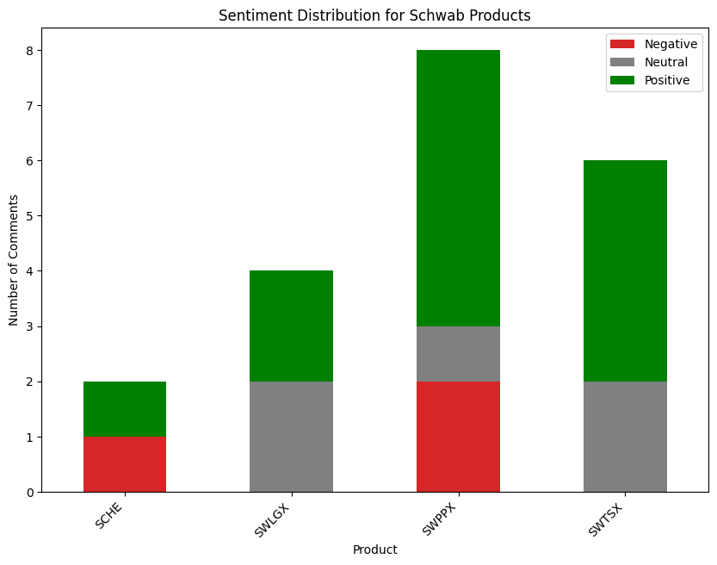
How do people
feel about Charles Schwab’s products?
12

Slide 13
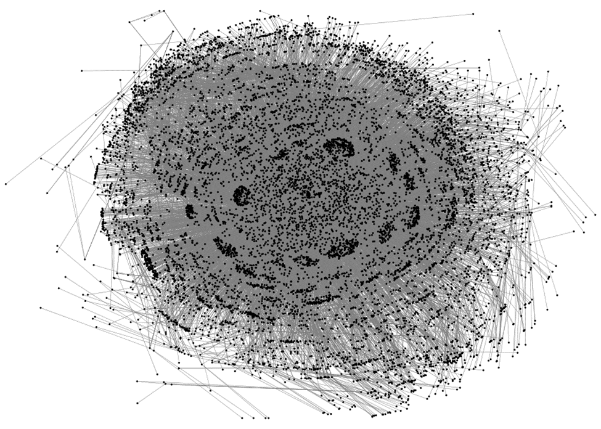
What’s new?
Network Analysis
Charles Schwab Corporation
13
Notes:
Ramin

Slide 14
Network Analysis
Why?
To find out the most active and influential contributors.
To plan a marketing strategy for any type of promotion.
How?
Gathering information on the number of interactions and UID's using Python.
Running Betweenness and Eigenvector centrality tests to analyze the data.
14
Notes:
Ramin

Slide 15
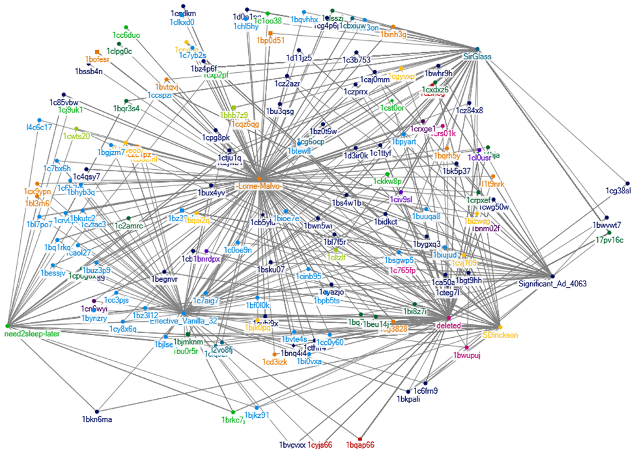
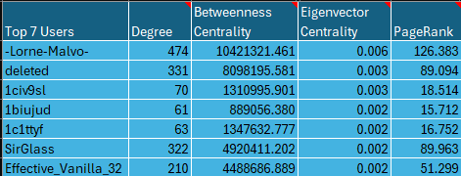
Network Analysis
Methodology
Undirect Helen-Koren Fast Multi Scale
Clauset-Newman-Moore
Schwab's Top Contributor
15
Notes:
Ramin

Slide 16
What’s new?
Developed Software
Charles Schwab Corporation
16

Slide 17
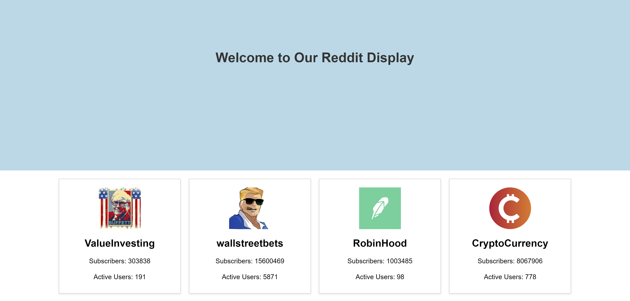

Slide 18
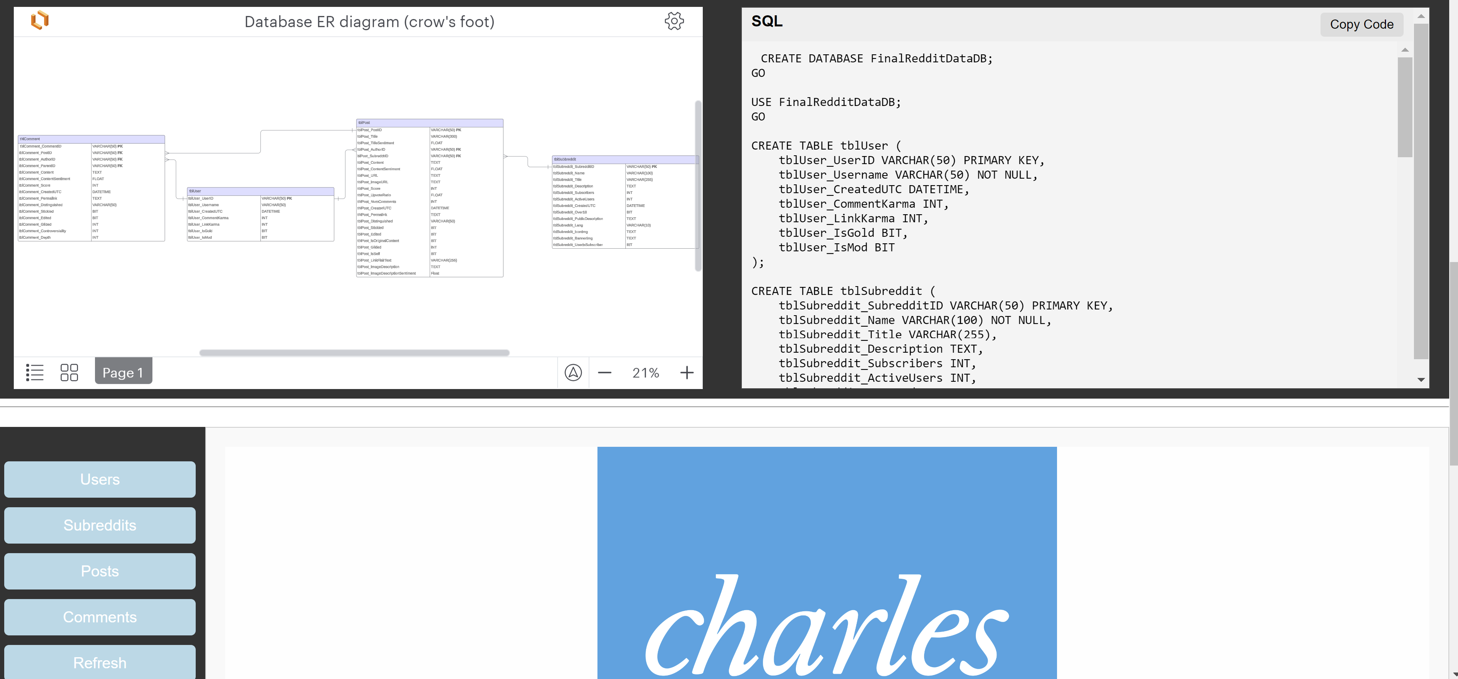

Slide 19
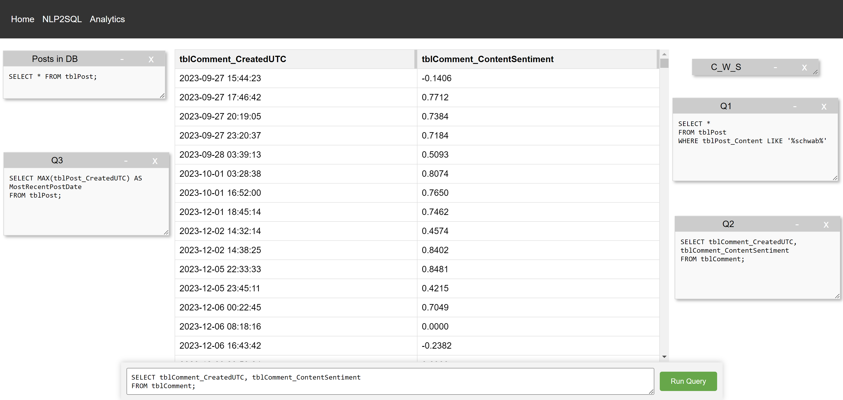

Slide 20
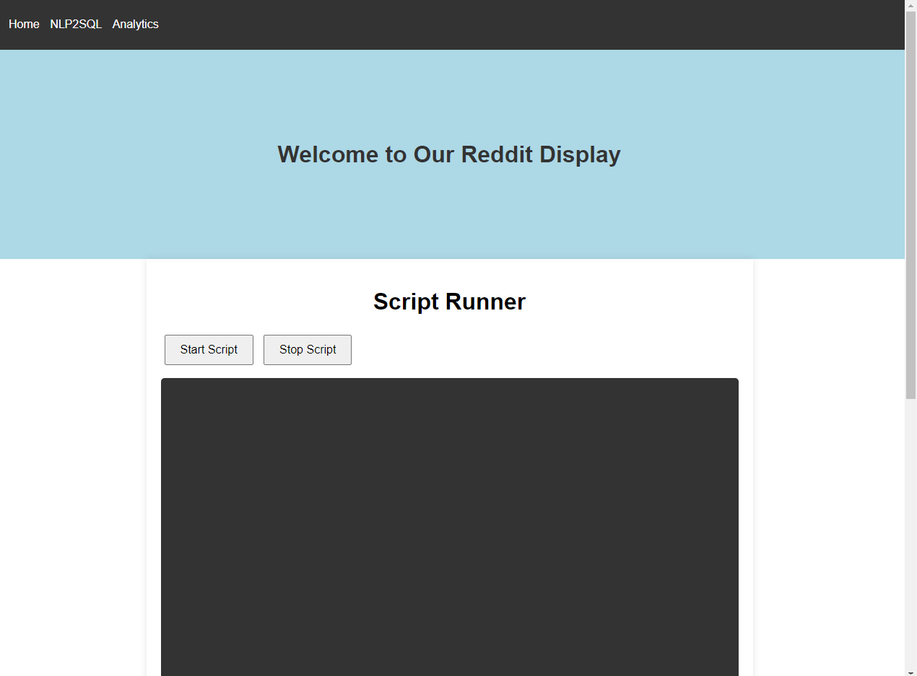

Slide 21
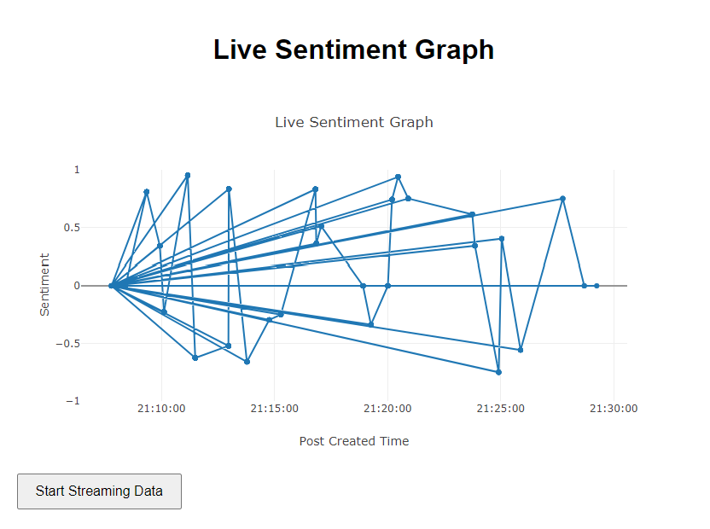
17

Slide 22
Objective Question
Should financial firms track their reputation on Reddit?
Charles Schwab Corporation
18

Slide 23
There is value to Reddit data
Why?
After refining our sentiment analysis, we found that there is value to measuring sentiment on Reddit, and responses to specific companies/products/ideas can be measured.
Also, contrary to some social platforms, Reddit has an online culture of advice giving and answering FAQ, which is why we decided that a network analysis would be appropriate to hone-in on individuals that are engaging the community and answering questions.
19
Notes:
Wes

Slide 24
Q&A
Thank You!
We are happy to answer your questions.
Charles Schwab Corporation
20

Slide 25
Appendix
Charles Schwab Corporation
18

Slide 26
Data Scraping and Cleaning
What we looked at in Python
Member Total
Active Users
Description
Rules
Moderaters
What we scraped using Python
Title
Author
ID
Score
Upvote Ratio
Date Posted
URL
5

Slide 27
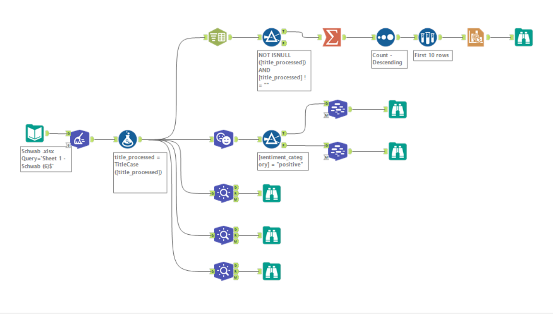
Alteryx Workflow
6

Slide 28
Analysis Results for r/Schwab
Charles Schwab Corporation
16

Slide 29
r/ Schwab
118 active users (Depends on time)
32,629 subscribers
Stats

Slide 30
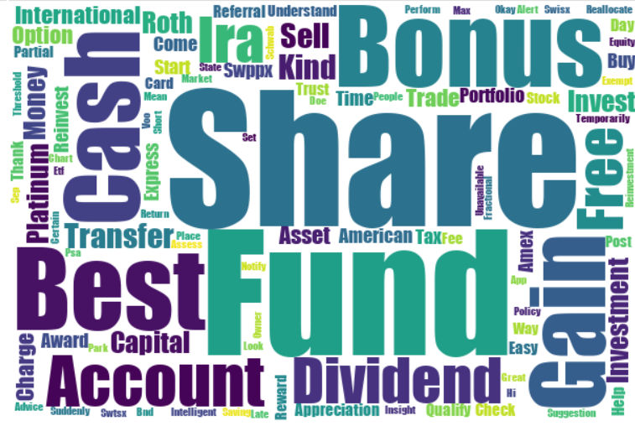
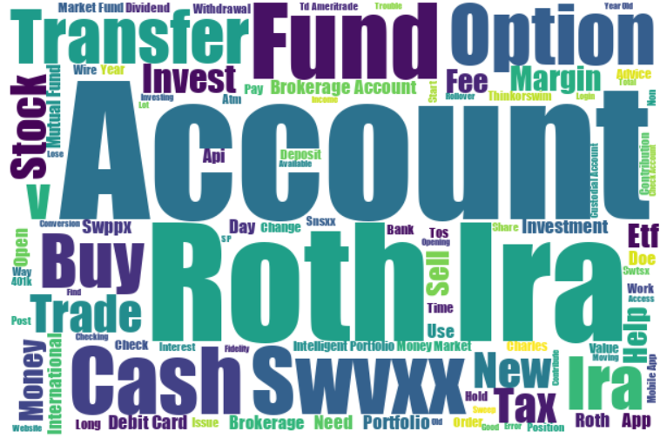
Positive
Title Sentiment Analysis
Schwab Sentiment Distribution
Negative
70
11
19
Negative
Neutral
Positive
7
Notes:
Jessica

Slide 31
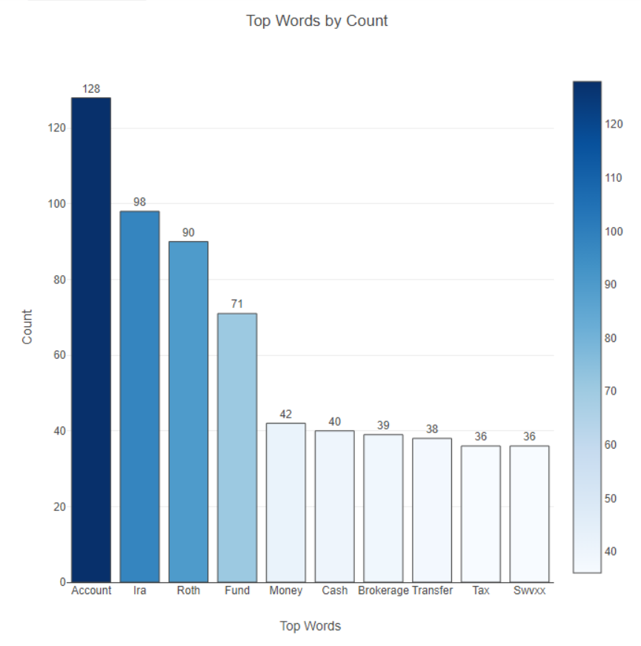
Alteryx Results: Top Words r/Schwab

Slide 32
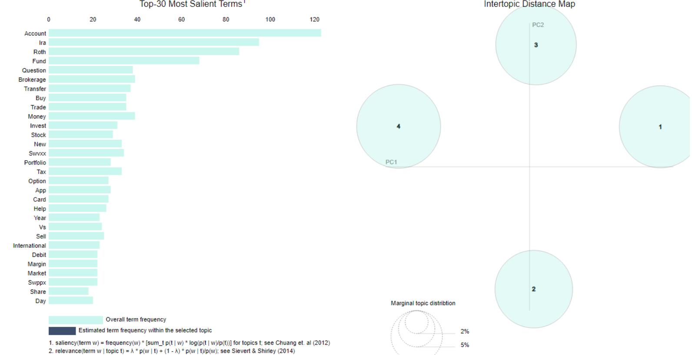
Topic Modeling
Optimal Model Criteria
3
Covers most of the dataset
4
1
No overlapping topics
Top r/Schwab Topics
Financial Services & Customer Support
Investment Strategies & Trading
Retirement & Investment Platforms
Mutual Funds & Market Transactions
2
8
Notes:
Jessica

Slide 33
Titles Sentiment Analysis & Top Words
Charles Schwab Corporation
16

Slide 34
r/fidelityinvestments
273 active users
115,240 subscribers
4 topics (work, investing, advice, account)
Stats

Slide 35
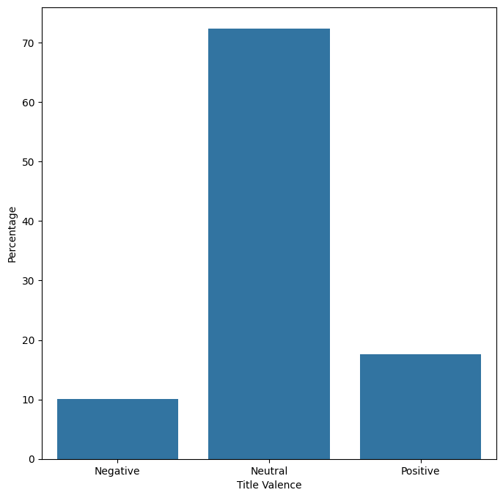
r/fidelityinvestments
Python Results

Slide 36
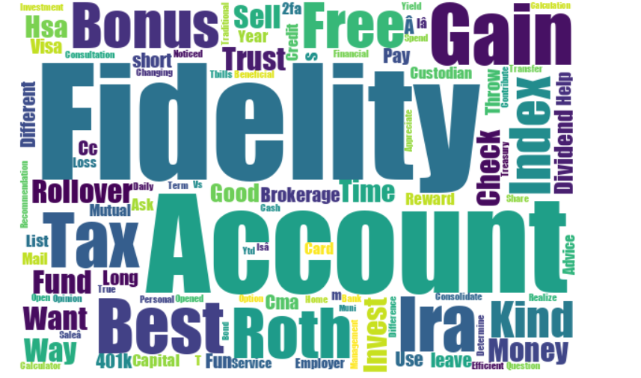
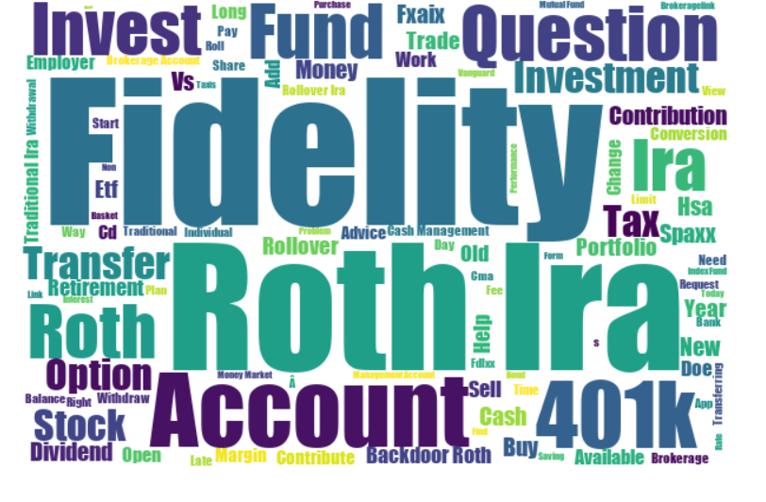
Alteryx Results
Positive
Negative

Slide 37
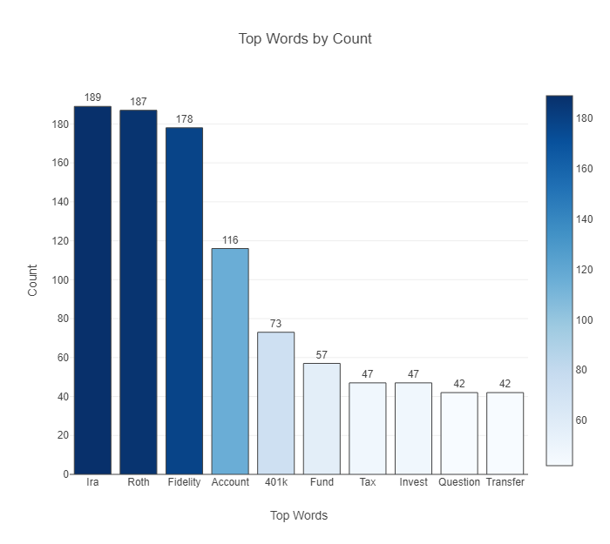
Alteryx Results

Slide 38
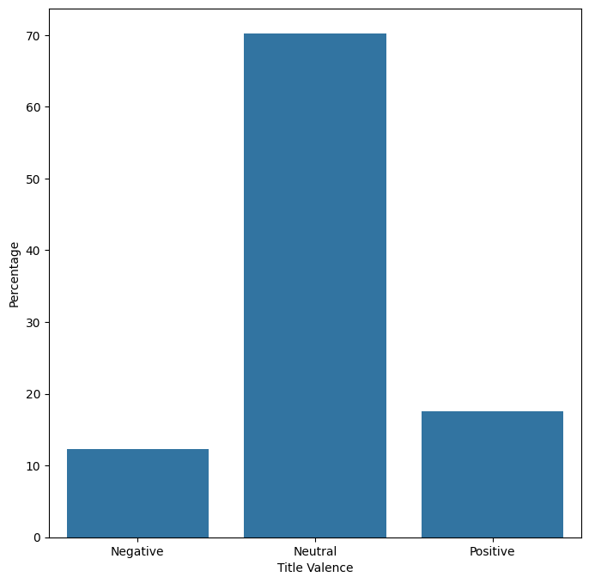
r/tastytrade
Python Results

Slide 39
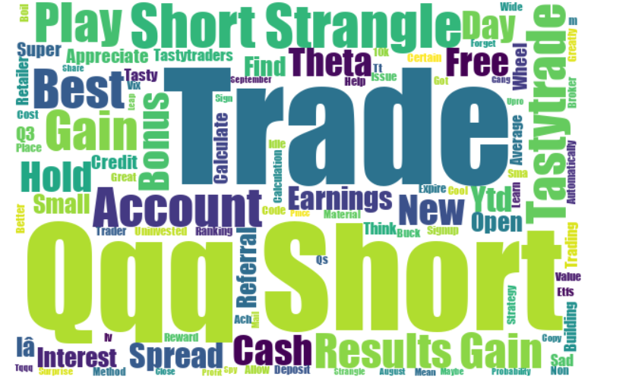
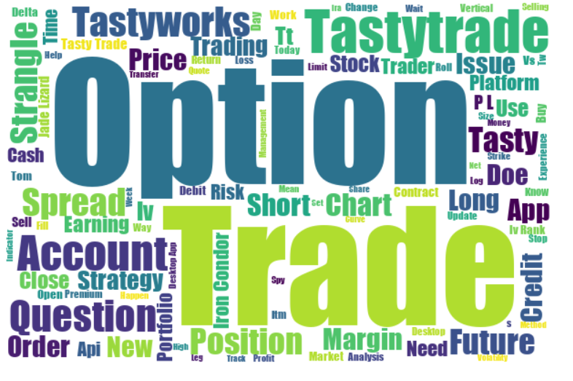
Alteryx Results
Positive
Negative

Slide 40
r/Wallstreetbets
6.8k Active users
15M Subscribers
Hottest topics: Daily trading and big corporation
Stats

Slide 41
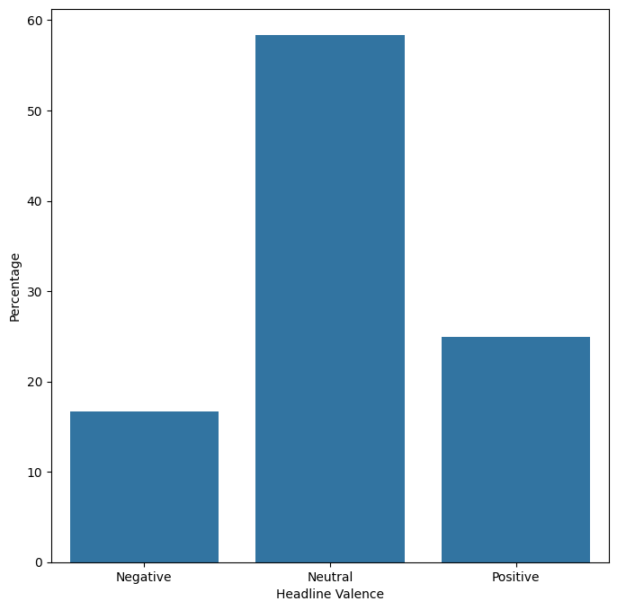
r/Wallstreetbets
Python Results
Notes:
The titles on r/fidelityinvestments are mostly neutral based on what we captured after conducting a sentiment analysis.

Slide 42
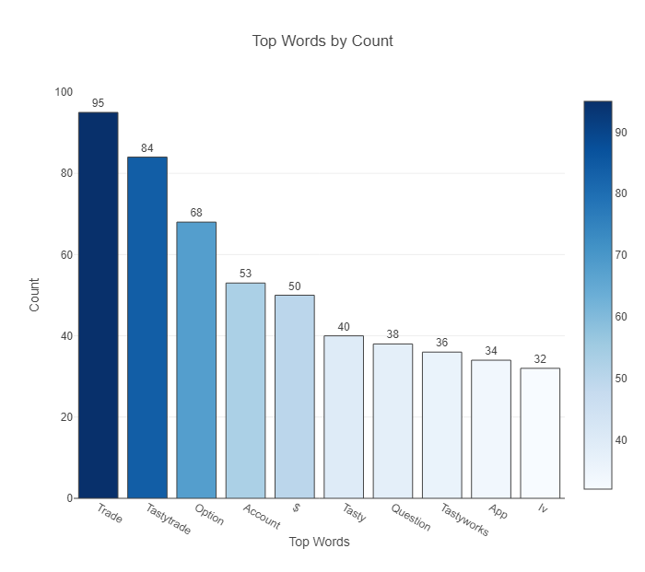
Alteryx Results

Slide 43
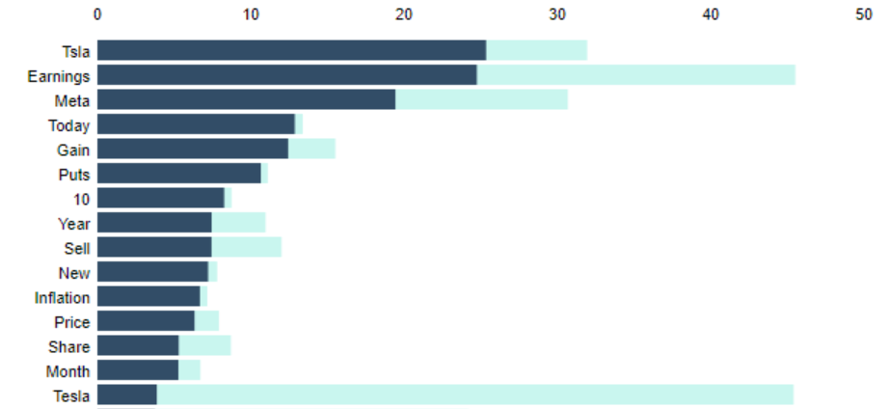
Alteryx Results

Slide 44
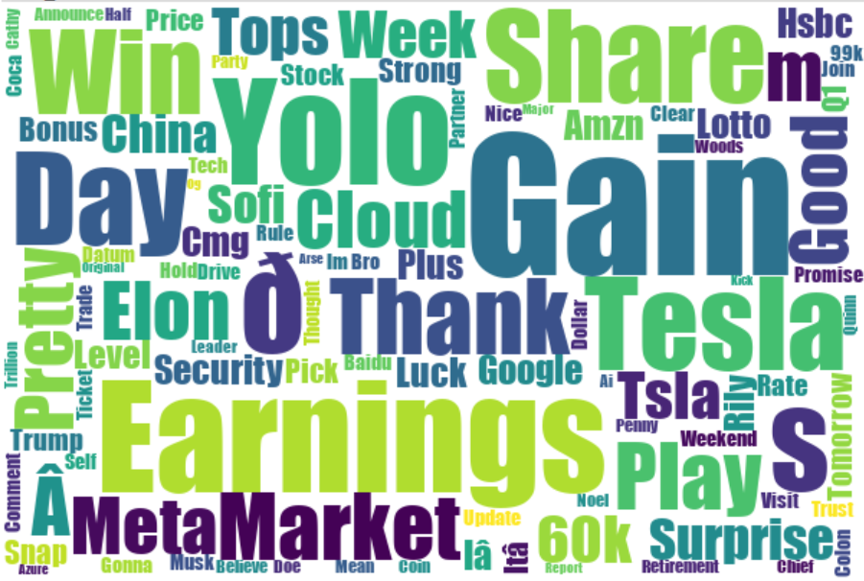
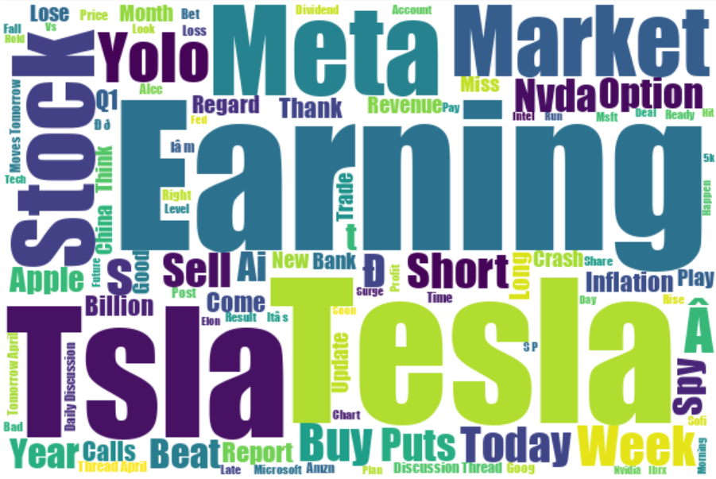
Alteryx Results
Positive
Negative

Slide 45
r/Bogleheads
100 Active users
424k Subscribers
Hottest topics: Retirement Accounts & help with daily trading.
Stats

Slide 46
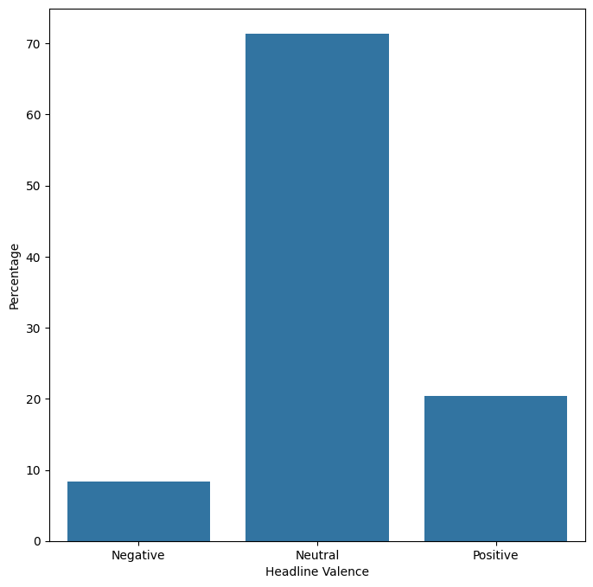
r/Bogleheads
Python Results
Notes:
The titles on r/fidelityinvestments are mostly neutral based on what we captured after conducting a sentiment analysis.

Slide 47
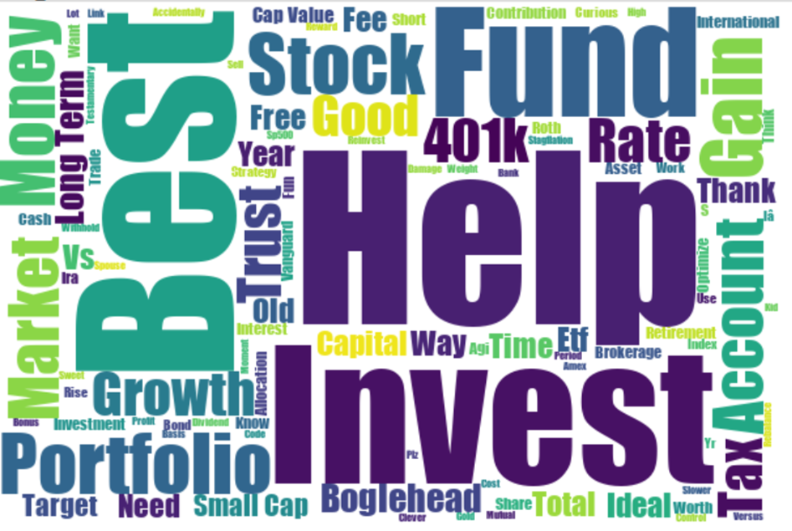
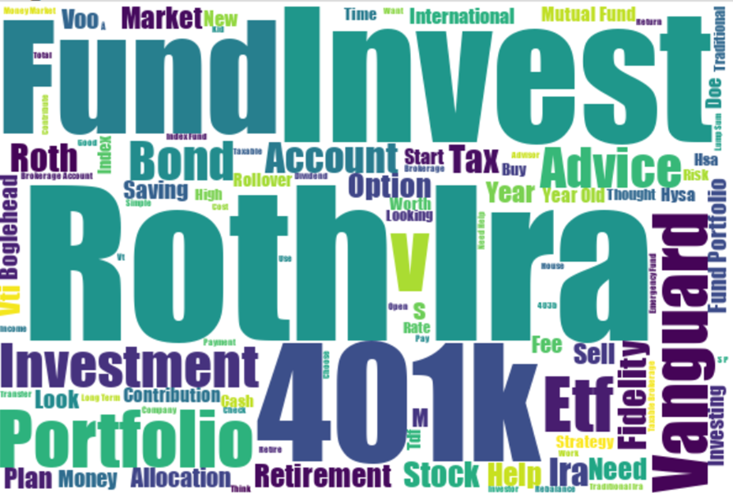
Alteryx Results
Positive
Negative

Slide 48
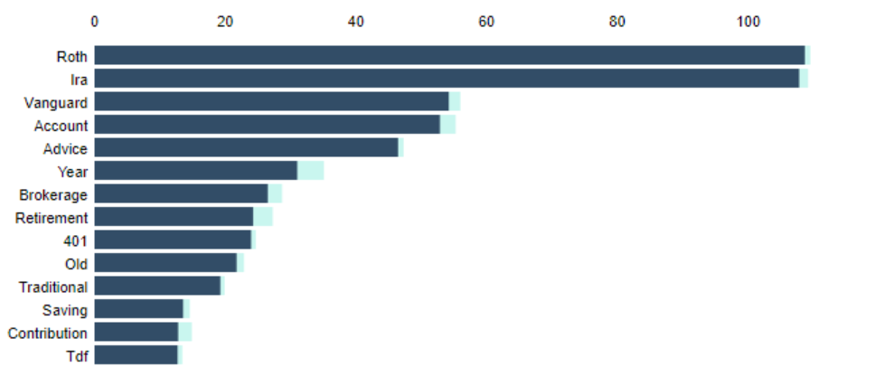
Alteryx Results

Slide 49
4 Subreddits
Comments Sentiment Analysis Results
Charles Schwab Corporation
16

Slide 50
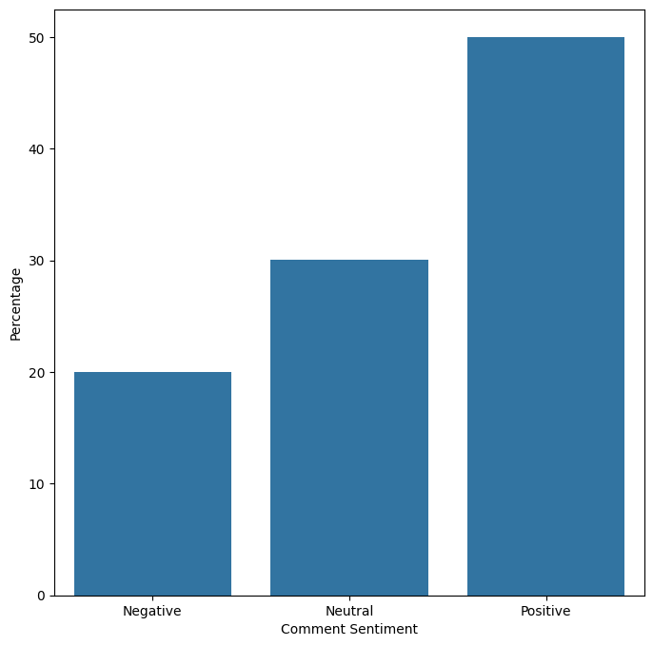
r/Charles Schwab Comments Sentiment Analysis

Slide 51
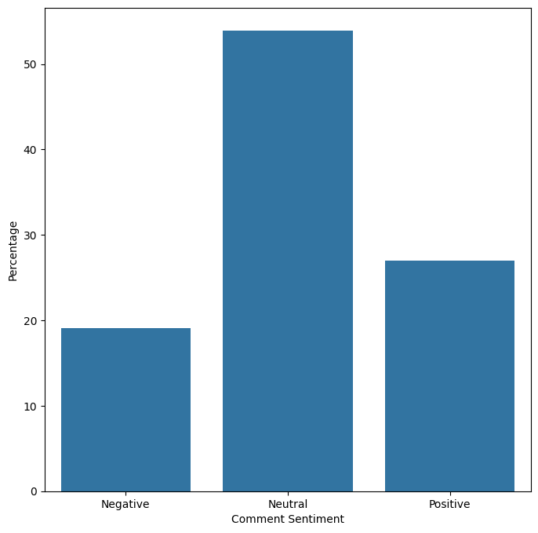
r/Wallstreetbets Comments Sentiment Analysis

Slide 52
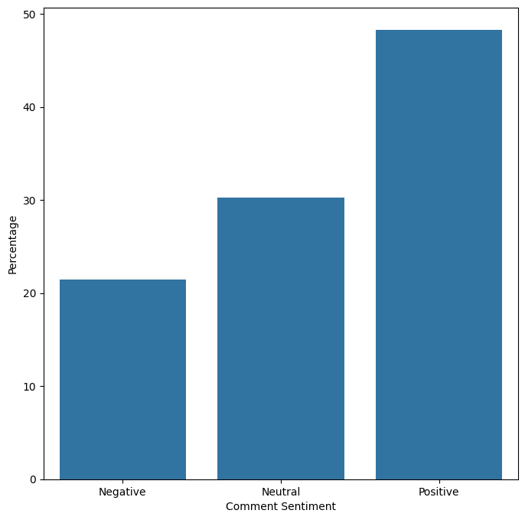
Investing Comments Sentiment Analysis

Slide 53
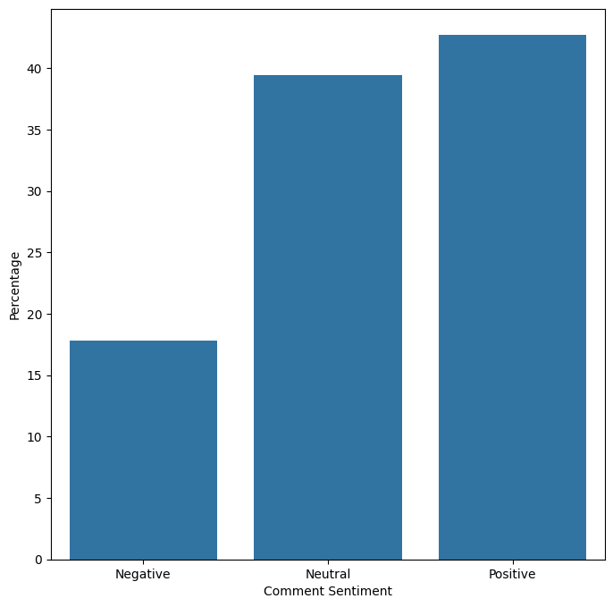
RobinHood Comments Sentiment Analysis

